Slide 1
Taxonomic Annotation
Metagenomics Lecture 1

Slide 2
Advanced Methods of Microbiome Study
In addition to marker gene surveys, we can also examine the microbiome with more robust sequencing techniques
Metagenomics sequences all of the DNA within a community
This provides information on bacterial abundance, as well as function
Involves the assembly of bacterial genomes
Metatranscriptomics sequences all bacterial mRNA
More accurately measures the changing function of a community
A snapshot of microbial expression – RNA turnover is fast!
Notes:
The tradeoff being price and computational power (which you will see in labs)

Slide 3
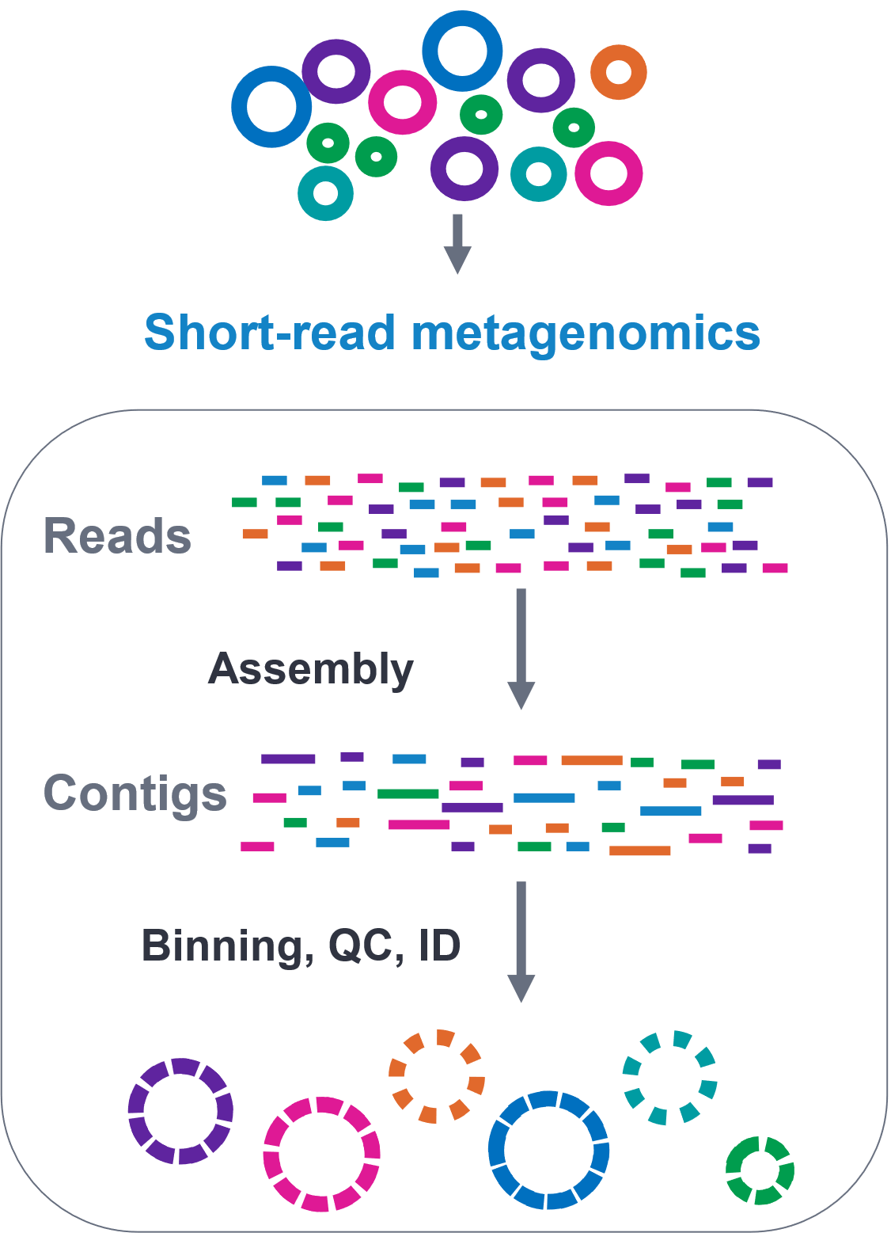
Metagenomics Workflow
DNA is sequenced from community sample, and the raw reads are processed in a variety of ways:
Taxonomic annotation
Contig assembly and binning
Functional annotation
Notes:
You can assign reads to a tax database similar to 16S. That what this lecture is
Contig assembly and binning allows you to recreate entire genomes – that’s what the figure is
Functional annotation can be either a comprehensive annotation like with uniprot, or a specialized one like card

Slide 4
Challenges with taxonomic annotation
Reads are short (for now)
Rare species are difficult to pick up
Lateral gene transfer
Computationally (and financially) expensive
Host-associated DNA
Notes:
Random, makes it hard to sort through
Short reads makes it more difficult to recreate those genomes, but long read tech is on the rise. Pacbio for instance is offering hifi metagenomic sequencing that supposedly can get you reference quality genomes
Some species are rare and wont produce enough material for genome assembly. Easier in 16s where all you need is the variable region
lateral gene transfer makes it difficult to assign taxonomy and to sort the right gene in the right genome
Mgx costs a lot! Just compared to the 16s labs you’ll see that processing this data is much more involved. The data is much larger and the tools youll need take much longer. The samples you start off with are also much more complex – you get host dna, repetitive regions, that all add up to larger sample files.
Because you are sequencing all of the DNA in a sample, you can have a high proportion of DNA that comes from your host. This is especially an issue for low-biomass samples, where you don’t have high microbial signal anyway. Failure to remove these reads can lead to spurious taxonomic designations

Slide 5
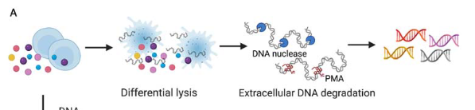
Removing host reads
Usually use short read-to-reference mappers, like BWA or Bowtie2
These are very fast and built for mapping against a large reference genome
There are a handful of tools that are built specifically for this purpose
Another option is host DNA depletion
Notes:
Downside is that they are not very sensitive – accuracy drops off below 90% similarity.
Explain host depletion – very expensive!

Slide 6
Approaches for Taxonomic Annotation
We can determine taxonomy directly from the reads
Can be done on all reads
This can be resource intensive
Allows for some form of quantification
Can be difficult due to the limited length of short-read sequencing
Or with a marker gene approach
Subsets the reads to those that appear to contain markers
As a result, difficult to link this back to function
Result can vary depending on genes used

Slide 7
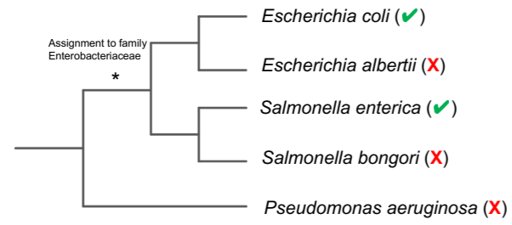
All Reads Approaches
Most use a k-mer based search method to speed up searches
One of the more is common tool is Kraken2 + Bracken
Uses lowest common ancestor (LCA) if not enough distinguishing characteristics
Notes:
Explain lca

Slide 8
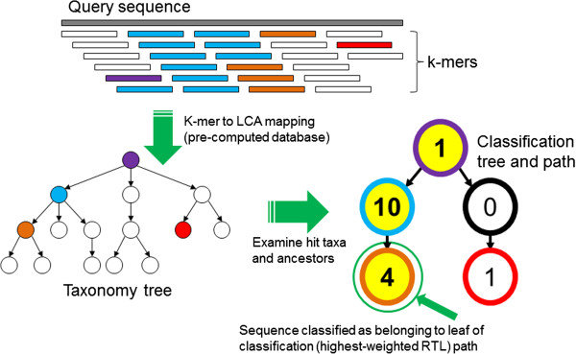
Kraken2
Generally fast and accurate
Kraken2 handles LCAs a bit differently
Based on scoring of root-to-leaf path
Scores weighted based on number of associated k-mers
Notes:
Because the reads are broken up into shorter kmers, you get a lot of different LCAs
You can also set cutoffs for your score

Slide 9
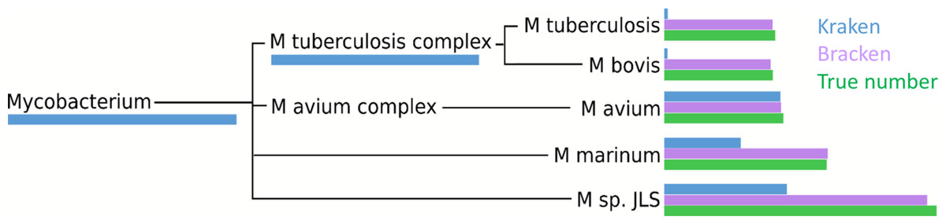
Kraken and Bracken
When there are a higher number of species, it can be difficult to get species-level resolution
Bracken attempts to redistribute ambiguous hits, particularly at the species-level, using probabilistic models
Notes:
We’ll be using both kraken and bracken for the workshop

Slide 10
Marker Based Approach
Single Gene
Can be restrictive
Several options for universal genes, including 16S variable regions and cpn60
Very little advantage over 16S
Multiple Genes
mOTUs3 – uses 10 universal single copy genes
MetaPhlAn4 – uses clade specific markers
Notes:
We won’t be using metaphlan nor motus3 in the workshop but its worth covering here.

Slide 11
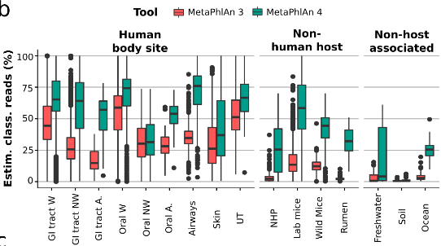
MetaPhlAn4
Well-supported and likely to continue receiving updates
Combines ~1 million bacterial and archaeal genomes, ~5 million markers
Groups genomes into species-level bins
Notes:
Used in conjunction with bowtie
Because it is reference based you can only detect tax that have been already sequenced

Slide 12
Kraken2 vs MetaPhlAn 3
Result can vary wildly on where data is sourced
MetaPhlAn 3
Faster and less resource intensive
Simpler to set-up
Good for human microbiome studies – not so much for environmental
Kraken2
Can require a lot of memory and resources
Some addition set-up required (increasing confidence threshold, installing Bracken)
More consistent with environmental and human data
Notes:
Note with metaphlan3, not 4

Slide 13
Which tool is best?
Plenty of benchmarking studies out there, and as many answers
Varying factors on these benchmarking studies:
Different databases/ tool versions
Different test datasets - simulated/ real
Different metrics for “best tool”
Paper | Van Uuffelen, 2024 | Poussin, 2022 | He, 2020
Data | Nanopore data | Public data | Simulated + Real
Criteria | Precision/ recall | P/R + Composition similarity | P/R +Predicted/True abundance distances
Result | Inconclusive | Kraken/ Bracken | Kraken or MMSeqs2

Slide 14
Alternatives to Short Read Annotation
Assembled Reads
Long Reads
Provides more information for taxonomic annotation
Trade-off is loss in diversity, possibly bias to the more dominant taxa
More information with longer reads
Still uncommon for now
Can use the same or similar methods to short read sequencing
Notes:
With assembled reads, depending on how you do it you are losing a some of those rarer taxa that didn’t make it into your mags or contigs

Slide 15
Metagenomics Labs
Running on new VM
Labs may bleed into each other
Tools take longer, more complex

